Slide 1
How Belgian medical ethics committees review clinical trials: An analysis of recurrent questions in ethics reviews of pilot CTR submissions (period 2017-2021), lessons learned?
INFOSESSION 10/03/2023
Audrey Van Scharen

Slide 2
Why?
After 7 years as a member of the CME UZ brussels, legal and vice-chairman, I noticed that, since the legal establishment of ethics committees in 1994, more and more legislation regulates medical scientific research. The ethics committees still have, approximately, the same composition and funding as in 1994.
PhD
What is the focus of Belgian research ethics committees in an ethics review of innovative (bio)medical reseach?

Slide 3
Why?
Questions:
What changes have recent European regulations brought to the composition, funding and review of ethics committees (officially)? (MDR – CTR – GDPR)
Who are the ethics committees? (unofficially)
What are the main points of attention of committees in a review?
Is there still room for ethics? What are the 'ethics' in the 'ethics review’?
How is the ethics review process different from the regulatory compliance check?
Is legal also ethical?
Should the composition and financing of ethics committees be reviewed and how?

Slide 4
How?
Review of the relevant legislation: Legislation founding the REC in Belgium 1994, Law experiments 2004, Law on the use of human tissues 2008, CTR + Belgian framework, MDR + Belgian framework, GDPR + Belgian framework, IVDR + Belgian framework
Literature review on ‘ethics principles’ in ethics review in (bio)medical research, the influence of legislation on (bio)medical research
Questionnaire to other member states on their review process
Review of all pilot RFI’s by independent REC
Review of the first year MDR REC review RFI’s

Slide 5
Contractual agreements
Confidentiality agreement was signed with FAHMP and FOD Health in July 2022
Evaluating EC is not a variable in the data processing of the research
The pilot number or CIV number is maintained in case extra information is needed
The CT-college will receive the database after publication of the first article and completion of all data processing (2023) – cfr: art. 9 of the Law of May 7th 2017 on clinical trials of medicinal products for human use
Notes:
3° ensure the consistent application of this law by the Ethics Committees. To this end, the College may make recommendations to the Ethics Committees;
4° formulating, on its own initiative or at the request of the Minister, opinions on the application of the Regulation, this Law and its implementing decrees;
5° coordinating, harmonizing, supporting, evaluating and monitoring the quality control performed by the Ethics Committees. The Board can issue recommendations to this end;
6° the administrative support of the Ethics Committees, with regard to the follow-up of the requests allocated in accordance with Article 7.

Slide 6
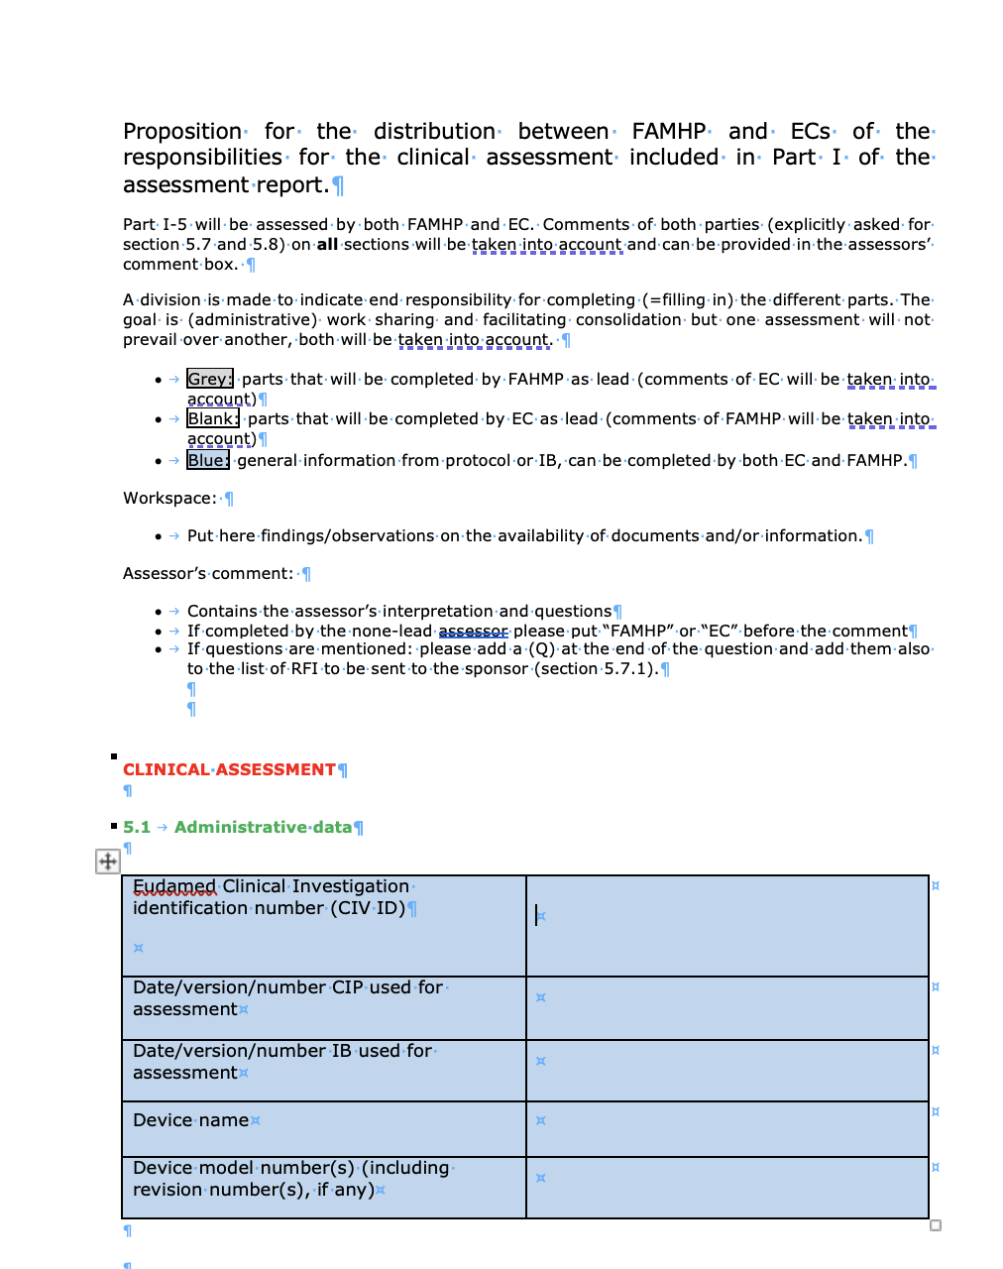
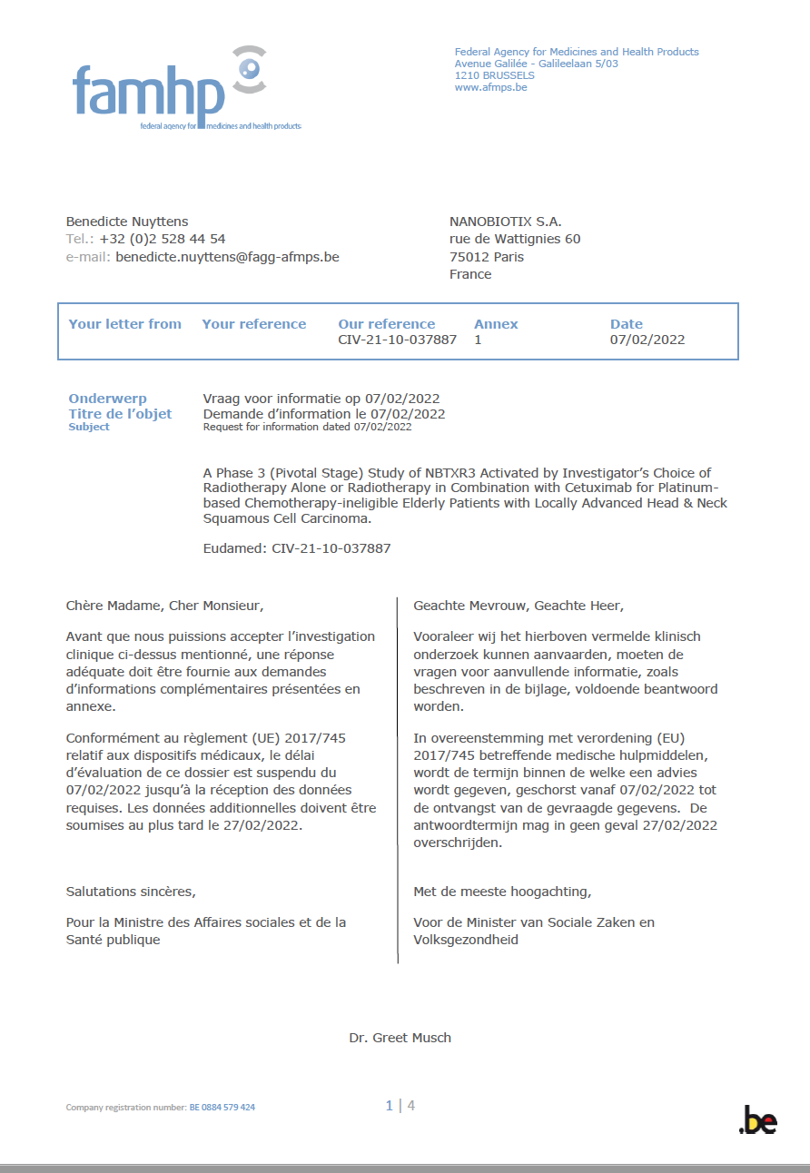
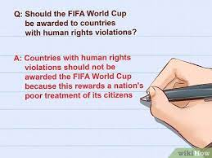
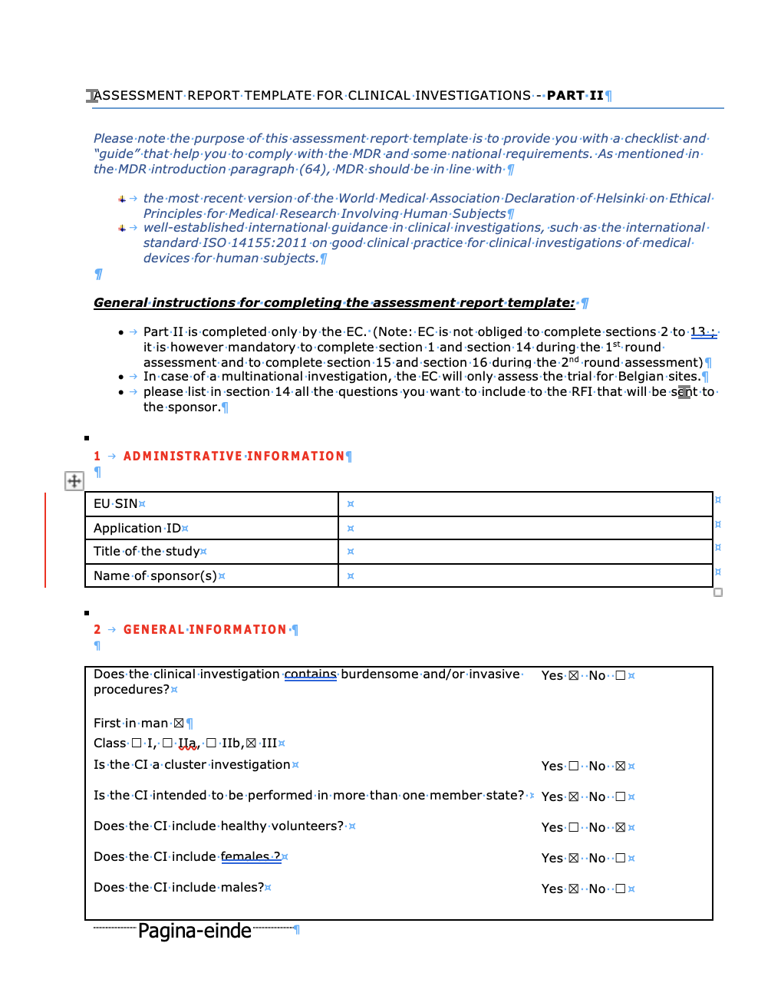
Object of the research RFI letters = request for information
PART 1 – art. 6 CTR
CT
- COLLEGE
CT
- COLLEGE
PART 2 – art. 7 CTR
Notes:
It should be left to the Member State concerned to determine the appropriate body or bodies to be involved in the assessment of the application to conduct a clinical trial and to organise the involvement of ethics committees within the timelines for the authorisation of that clinical trial as set out in this Regulation. Such decisions are a matter of internal organisation for each Member State. When determining the appropriate body or bodies, Member States should ensure the involvement of laypersons, in particular patients or patients' organisations. They should also ensure that the necessary expertise is available. In accordance with international guidelines, the assessment should be done jointly by a reasonable number of persons who collectively have the necessary qualifications and experience. The persons assessing the application should be independent of the sponsor, the clinical trial site, and the investigators involved, as well as free from any other undue influence.

Slide 7
Method – data gathering
The data of all pilots (476)
- RFI letters
- commented ICFs
- Assessment forms on all parts
Were transferred on a Owncloud drive shared between the CT college and the researcher

Slide 8
Method – data gathering
An excel file made by the CT college with an overview of the pilots/clinical investigations was shared with the researcher, containing basic information about the files.
CTR pilots: Pilot number, EUDRACT, "Domain/Therapeutic area", Phase, validation = T0, Conclusion FAMHP, Conclusion EC, Consolidated final conclusion
N° RFI total =
n° RFI typo’s, language, coherence
+ n° RFI Part I + n° RFI Part II

Slide 9
How do I count the RFI’s?
Discourse analyses

Slide 10
Method – data processing
In excel predefined categories were made to process each RFI (question) of an EC in the RFI letter, generating dropdown options
The categories were based on the assessment form as ‘used’ by the ECs.
Even if the assessment form was not filled in the question was categories in one of the titles and related remarks of the assessment form.
Disclaimer:
This was done at best effort by the researcher.
For part I the assessment form was always double checked, to be able to link the question to a category.
No judgement, just facts
Notes:
I did not look up or process the EC name. However I will use examples in this presentation. Please know, if you recognise your ec, that I or others here present do not. In no way the examples or specifically highlighted cases are ment to stigmatise a specific EC. Reveiling that the remark/ procedure or specific question is coming from your EC is your choice.

Slide 16
Written information – 42 options
The information sheet does not describe adequately and consistently with the protocol the nature, objectives, benefits, implications, risks, and inconveniences, of the clinical investigation
The information sheet does not adequately specify the reason why the subject is asked to participate
The information sheet does not adequately describe the subject's rights and guarantees regarding his or her protection, in particular his or her right to refuse to participate and the right to withdraw the informed consent at any time without any resulting detriment and without having to provide any justification
The information sheet does not adequately explain that withdrawal of the informed consent will not affect the results of activities already carried out and the use of data obtained, based on informed consent, before its withdrawal
For a investigation in an emergency situation (without prior informed consent from the subject), the information sheet does not adequately explain that, if the subject or, where applicable, his or her legal representative does not give consent, he or she has the right to object to the use of data obtained from the clinical investigation
The information sheet does not adequately describe the conditions under which the clinical investigation is to be conducted, including the expected duration of the subject's participation in the clinical investigation
The information sheet does not adequately describe the financing of the clinical investigation and the arrangements for financial transactions and for compensation to the subject.
The information sheet does not adequately describe the possible treatment alternatives
The information sheet does not adequately describe the follow-up measures if the participation of the subject in the clinical investigation is discontinued
The information sheet does not adequately describe Post-investigation treatment options
The information sheet does not provide information about the no-fault insurance
The information sheet does not mention the insurer’s contact information
The information sheet does not provide the EU SIN or ID application number
The information sheet does not provide information that understandable information about the clinical investigation report and summary that will be made available
The information sheet does not provide contact detailsto the subjects for further information on the investigation in case of questions
The information sheet does not provide information planned personal data collection and processing
The information sheet does not provide information who may access the original medical records
The information sheet does not provide information for what limited purpose the original medical records can be accessed
The information sheet does not provide information that at all times all relevant persons are bound by confidentiality obligations or professional secrecy and in any event by applicable laws on data protection
The data will be used for other purposes than the investigation (e.g. future research not described in the protocol) and the subject is not informed that any such future research needs additional approval of an ethics committee
The data will be used for other purposes than the investigation (e.g. future research not described in the protocol) and the consent for such future research is not made optional for the subject (e.g. by using a ticking box or a separate optional informed consent form)
The data will be used for other purposes than the investigation (e.g. future research not described in the protocol) and the subject is not informed that his consent may be withdrawn at any time by the subject or his or her legal representative
The information sheet does not provide adequate (and consistent with the protocol) information about which, when and how many biological samples will be donated / procured / collected and the use of these biological samples
The information sheet does not provide adequate information on whether the subject will be informed about any new personal information derived from investigating his/her samples (genetic or other) or other incidental findings
The information sheet does not provide a discription and motivation how long the biological samples will be stored
The information sheet does not provide information on what will happen after the investigation completion with the collected biological samples (e.g. destruction, return, future research, anonymization,…)
The name and location of the manager of the biological samples is not defined
In case of anonymization, is the subject is not informed that the traceability of his/her samples will be lost
The anonymisation of the samples is not made optional to the subject
The biological samples will be used for future research not described in the protocol and the information sheet does not provides adequate information about planned donation, procurement, testing, processing, preservation, storage and distribution of the biological samples
The biological samples will be used for future research not described in the protocol subject is not informed that any such future research may only be conducted with an additional explicit consent or the approval of an ethics committee
The biological samples will be used for future research not described in the protocol and the consent for future research is not made optional for the subject (e.g. by using a ticking box or a separate optional informed consent form).
The biological samples will be used for future research not described in the protocol future research is not sufficiently limited (e.g. to the investigated disease and IMP(s)).
In the case of a investigation with minors, assents with regard of the involved age groups are not present
In the case of a investigation with minors, there are no Informed Consent documents for the parents/ legal representative
In the case of a investigation with minors, the Informed Consent documents are not adequately paying attention to language and the information needs of the involved age groups
In the case of a investigation with incapacitated subjects there are no Informed Consent documents for the legal representative
In the case of a investigation with incapacitated subjects, the Informed Consent documents are not adequately paying attention to the information needs of these subjects
In the case of a investigation in an emergency situation there are no Informed Consent documents to obtain consent from the subject and/or legal representative to continue the participation of the subject in the CT after initiation of the investigation-related intervention
Is it foreseen in the ICF procedure and/or assent form that a minor reaching the age of legal competence will have to re-express his/her informed consent before he/she can continue to participate in the clinical investigation?
"If yes, in case the subject or, where applicable, his or her legally designated representative does not give consent:
the subject is not informed of the right to object to the use of data obtained from the clinical investigation as soon as he/she is capable to give informed consent"
other

Slide 17
Label ‘other’ in part 2 (not mentioned in AF)
Include ‘trial at a glance’
Time needed to fill out the questionnaires
Request to use the template
Foreign legislation
Wrong EC mentioned
Specify the applicable legislation
Update legislation to GDPR and law 2018
Missing documents
Clarify anonimisation or pseudonimisation
Duration of the insurance is not long enough
the ICF is too long

Slide 18
Status today
Total
Number of EC RFI letters
Pilot (476)
Total
Processed 10/03/2023
Pilot
(25%)
Total
Number of questions processed
10/03/2023
3647

Slide 19
Numbers

Slide 20
Preliminary results pilot
Reviewed 128 clinical trials
Validated between 22/05/2017 and 16/11/2021
2017 (9), 2018 (32), 2019 (26), 2020 (32), 2021 (27)
Notes:
0

Slide 21
EC RFI numbers pilot
Total
Number of EC RFI questions
3647
Total
Number of EC RFI questions on part I
444
Total
Number of RFI questions on part II content (typo’s, coherence and language use excluded)
1519
Total
Number of EC RFI on typo’s, coherence and language use
1706

Slide 22
EC RFI numbers pilot
On average a clinical trial would receive an RFI letter with 28,4 EC remarks
3,4 remarks on part 1
11,8 remarks on part 2 content
13,3 remarks on typo’s, coherence and language use in consent forms

Slide 23
Highest number of remarks - pilot
Notes:
Highlighted comments in the ICF → higher number of remarks / future in CETIS?

Slide 24
Averages RFI per year
 | Percentage processed | Number of pilots processed | Average number of RFI | Remarks about typos, coherence, language use | Content part I | Content part II
2017 | 100% | 9 | 34 | 22,11 | 2 | 10,55
2018 | 94% | 32 | 26,53 | 10,84 | 4,06 | 11,56
2019 | 30% | 26 | 42 | 22,5 | 3 | 15
2020 | 15% | 32 | 23,71 | 9,34 | 3,6 | 11,56
2021 | 20% | 27 | 22,89 | 9,8 | 3 | 10,42

Slide 25
Nuances for the numbers
not every trial is the same
(difficult, easy)
or experienced sponsors
apply GDPR or enumerate every step (controller DPA, coding…)
repeating the same comment several times each time it applies, FI 'specify the amount of blood drawn'
difference in ICF comments, reviewing all ICFs or stating ‘we expect the same adaptations when necessary’
level of detail: working with examples
Versus
mention when there needs to be more spacing

Slide 26
Remarks about typos, language and coherence
lac of coherence: approach, detail by the EC’s

Slide 27
Very different approaches between ECs
Examples of language mistakes
All the mistakes of one ICF are mentioned in the RFI letter, adding they apply to all versions of ICF (f.i. ascent, pregnant partner)
All mistakes of all ICFs are mentioned in the RFI letter, each as a question.
EC questions are made in the ICFs documents as comments
The ICF are printed and scanned with remarks
CTIS?

Slide 28
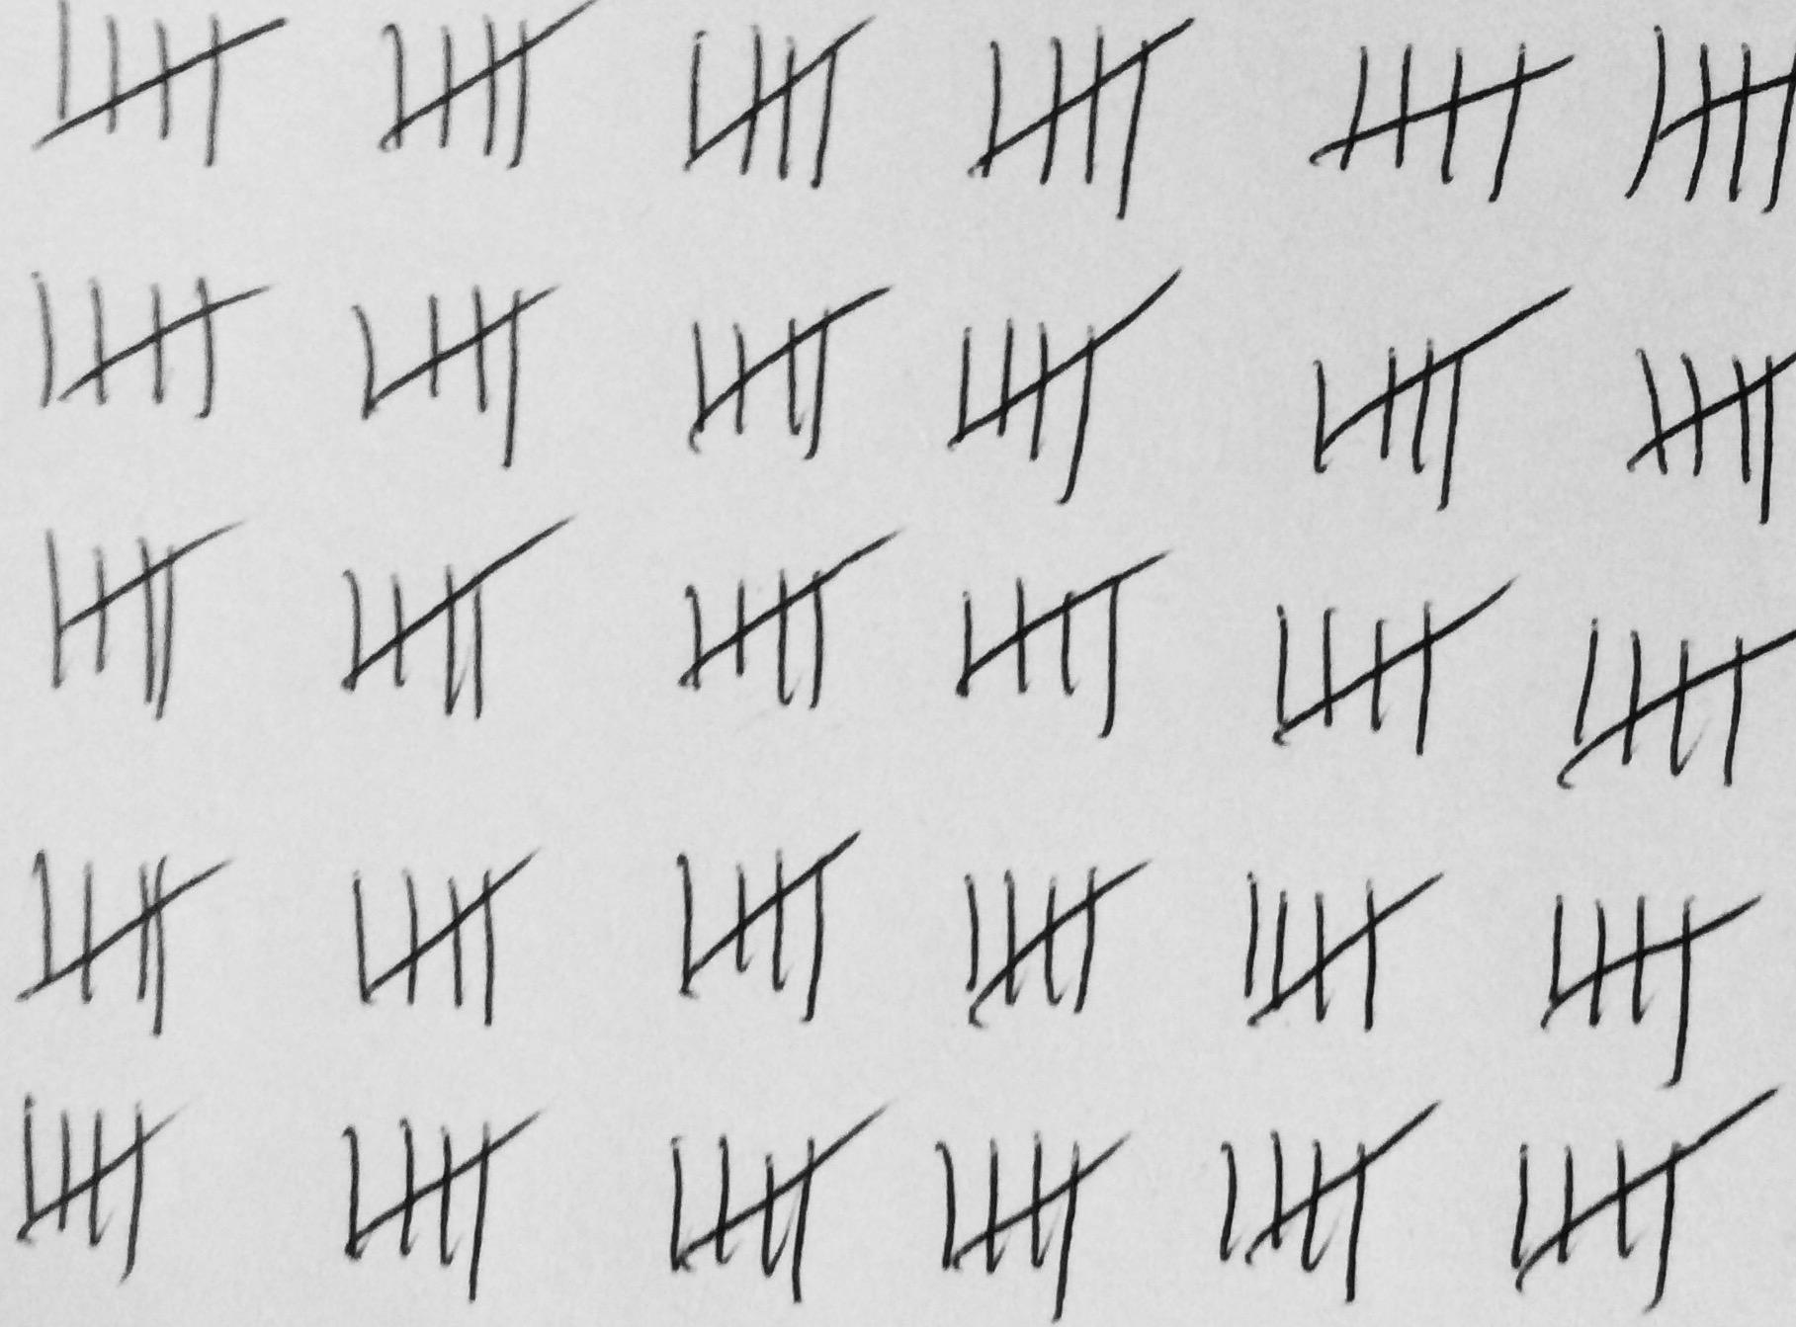
1519

Slide 29
Remarks about typos, language and coherence – examples
“deze kunnen bij u thuis” instead of “deze kunnen bij uw thuis”
“het uitvoeren van academisch onderzoek” instead of “het uitvoeren van academische onderzoek”
“end an ook naar jou luisteren” instead of “en dan ook naar jouw luisteren”
Q13: Page 5: “tijdsspanne” -> typo: “tijdspanne”
Effets secondaires”: replace “trou” by “perforation”
The information Sheet contains some difficult terms that should be (briefly) clarified to the participants. Examples are: ‘CE markering’, ‘corticosteroïden’, ‘cytokines’.
The terms used (especially for side effects) in the “assent for child” are not easy to understand for a child. Please simplify terms like “boursouflures” or “desquamation.”
"Concerning page 9: ‘Bij je eerste bezoek zal je onderzoeker controleren of je geschikt bent om aan de studie deel te nemen.’ Please reformulate: ‘Bij je eerste bezoek zal je onderzoeker controleren of je in aanmerking komt om aan de studie deel te nemen.’.”
p.5/7: point 10: Add “codées” after “données médicales”/ 3rd§: replace “pseudonymisées” with “codées” / Same remark elsewhere
Check spelling “Déroulement pour les participant.e.s“.
P11: Review punctuation.
Lastly, we have noticed added some language comments in the myCordella Patient Reader Manual as well as Cordella Patient Implant Leaflet (see attachments). Please correct.
Please move this paragraph up
15.2: Commas are missing.
Delete “gratuits” and replace by “pris en charge par le promoteur.”

Slide 30
Example on coherence remarks
1. It is frequently referred to the FDA and the US. As this study will occur in Belgium, ensure to provide details about Europe and the EMA.
2. Kindly provide a clearer explanation. On P.2 it is mentioned “11 jours d’examens” while P.3 mentions “10 jours d’examens”. « Période de 10 semaines » is mentioned on P.2 and “Période de 6 semaines” on P.3.
3. 11/2021 (Did not use template) The structure of the ICF is not clear, due to the lack of a clear paragraph hierarchy (only bold, underlined and / or italic formatting is used; the reader loses track along the first pages) and the absence of a content table. Please add title numbers (e.g. 1, 1.1, etc.) for all titles and provide a content table at the beginning of the ICF.

Slide 31
Advice to industry – language/ typo./ coherence → create goodwill
Use the ICF template!
Proofread by native speaker
Avoid sloppiness (f.i. typos, wrong bookmarks, different fonts, …)
Easy check: Are all abbreviations explained?
Include a patient/lay person in the ICF writing process to verify understandability
Declaration of translator?

Slide 32
Pilot CTR analyses

Slide 33
Part I: Most frequent questions on
Statistical
Data protection protocol
Clinical trial rationale
Safety and monitoring
Exclusion criteria
Inclusion criteria
Safety risks
Other concomitant therapy
Notes:
Box ticked f.i. safety acceptable and still a question As mentioned previously, four families with missense mutations of the NT5E gene that encodes CD73 have been described (St Hilaire et al, NEJM, 364:432, 2011; Ichikawa et al, J Clin Rheumatol 21:216, 2015). Family members had calcifications of the lower extremity arteries and hand and foot joint capsules. One wonders if specific attention will be given to those potential adverse effects of oleclumab.

Slide 34
Part II: Most frequent questions on
Most questions on:
Written information (ICF text)
ICF (signing)
Data protection
Suitability of the investigator
Proof of insurance
Recruitment
Financial and other arrangements
Notes:
Biological samples
(cfr. Remarks in written information)

Slide 35
Written information: Most frequent questions on
What will happen during the trial? (The information sheet does not adequately describe the conditions under which the clinical trial is to be conducted, including the expected duration of the subject's participation in the clinical trial)
Data processing information (The information sheet does not provide information planned personal data collection and processing)
Information about the trial, risks… (The information sheet does not describe adequately and consistently with the protocol the nature, objectives, benefits, implications, risks, and inconveniences, of the clinical trial)
What is the compensation, what will be paid by the sponsor, standard of care vs specific to the trial (The information sheet does not adequately describe the financing of the clinical trial and the arrangements for financial transactions and for compensation to the subject.)
Notes:
PartII Written_information The information sheet does not describe adequately and consistently with the protocol the nature, objectives, benefits, implications, risks, and inconveniences, of the clinical trial section « neuropathie périphérique » : It would be useful to indicate the frequency of occurrence of this type of side effect rather than a vague indication such as "certains patients". Idem for section «faible numération sanguine » (30% :peripheral neuropathy –see above also-; 80% : hematological malignancy). Voorbeeld PartII Written_information The information sheet does not describe adequately and consistently with the protocol the nature, objectives, benefits, implications, risks, and inconveniences, of the clinical trial section « effets secondaires fréquents (pouvant toucher plus de 1 personne sur 10): The frequency is the same as that used for « very frequent side effects » (1 in 10 people). For frequent side effects, it is more likely to be « more than 1 in 100 patients but less than 1 in 10 patients ». Please correct it.
„redelijke bijkomende vervoerskosten“
side effects are pooled, we think it would be more informative to split them according to the considered regimen and to specify the frequency of occurrence.
In the text, it is not clear whether the patients
will be hospitalized and until when. Some
details are to be provided on this aspect for a
better understanding
A phone call is planned during follow-up. Who
will contact the patient ? What happens if the
patient can not be contacted ? (Q)

Slide 36
Written information RFI examples of “What will happen during the trial?” (conditions)
1. “In the text, it is not clear whether the patients will be hospitalized and until when. Some details are to be provided on this aspect for a better understanding”
2. “A phone call is planned during follow-up. Who will contact the patient ? What happens if the patient can not be contacted ?”
3. “In the protocol you mentioned that you will record Patient-Reported Outcomes through home ePRO devices. You only mentioned in the informed consent : « De répondre à des questionnaires en lien avec l’étude dès que le dispositif électronique vous y invitera ». Never you stated how much time each questionnaire will take and how you will learn to use this device.”
4. “U wordt gevraagd een vragenlijst in te vullen over uw levenskwaliteit. How many time will the subject need to do this ?”
5. “Les recherches génétiques seront faites uniquement à des fins génétiques This seems obvious. What is the exact message ? ”
Template ICF - “Trial at a glance”

Slide 37
Written information RFI examples of Data processing information
1. “Regarding the transfer of data outside Europe, could you please indicate that the measures will be ‘equivalent to the ones required by the European regulation’ and not ‘appropriate’.”
2. Missing information: rights, dpo, GBA
3. DPO of the site, not sponsor

Slide 38
Written information RFI examples of Information about the trial, risks… (consistency with protocol)
1. “It would be useful to indicate the frequency of occurrence of this type of side effect rather than a vague indication such as "certains patients". Idem for section «faible numération sanguine » (30% :peripheral neuropathy –see above also-; 80% : hematological malignancy)."
2. « effets secondaires fréquents (pouvant toucher plus de 1 personne sur 10): The frequency is the same as that used for « very frequent side effects » (1 in 10 people). For frequent side effects, it is more likely to be « more than 1 in 100 patients but less than 1 in 10 patients ». Please correct it.
3. “side effects are pooled, we think it would be more informative to split them according to the considered regimen and to specify the frequency of occurrence."
Template ICF - “Trial at a glance”

Slide 39
Written information RFI examples of What is the compensation, what will be paid by the sponsor, standard of care vs specific to the trial ?
1. „redelijke bijkomende vervoerskosten” is not accepted, be more precise.
2. “Patient are paid € 100 per study visit + € 35 for transportation costs. This is not mentioned in the ICF but can be retrieved from the financial arrangement. This is unacceptable.”
3. “U krijgt een vergoeding tot € 100 per studiebezoek. Boven op deze vergoeding voor studiebezoeken krijgt u een aanvullende verplaatsingsvergoeding van € 35 per bezoek.’ Does this reimbursement of up to 100 euro only include the expenses or is the patient paid a standard amount? We cannot allow the patient to be financially influenced to participate in the clinical trial.”
4. “The EC has major concerns regarding what is indicated as not study-specific in the table. The EC has consulted a external aspect on this matter. A follow-up of 2 years with a 3-monthly scan is not to be considered as standard care. Please adapt this table to more realistic norms.”
5. “Is any compensation for subjects foreseen for study-specific visits (e.g., transportation, parking)? Please add more information on this point”

Slide 40
First conclusions
Harmonisation

Slide 41
First conclusions for the EC review improvement
Financed professional BAREC or/and CT-college takes lead in harmonising
Suggestions for harmonisation:
Trial at a glance made mandatory with guiding questions
Mandatory/repetitive training for members of ECs and coordination staff?
More symposia?
Mandatory templates ICF/Assent
Will CTIS influence the considerations?
Notes:
EC member volunary – Barec involvment voluntary upon voluntary
And coordination staf of EC’s are already overwelmed with new procedure and more trials/investions and responsabilities (f. i. ) GDPR, biobanks
BAREC

Slide 42
First conclusions for sponsors
Are sponsors sloppy?
Do sponsors count on the first review of the EC to finetune their documents, for instance a language check?
! 1 RFI round !
Evolution in number of remarks?
Noticeable evolution for remarks in ICF template use (pilot)
Notes:
EC member volunary – Barec involvment voluntary upon voluntary
And coordination staf of EC’s are already overwelmed with new procedure and more trials/investions and responsabilities (f. i. ) GDPR, biobanks
BAREC

Slide 43
HOW TO AVOID RFI?
Avoid moody ethics committees by seemingly sloppy work, use the agreed upon frameworks and templates
Use the ICF template! + trial at a glance
Proofread by native speaker
Avoid sloppiness (f.i. typos, wrong bookmarks, different fonts, …)
Easy check: Are all abbreviations explained?
Include a patient/lay person in the ICF writing process to verify understandability
Include statistician
Use the assessment form as a checklist
Notes:
EC member volunary – Barec involvment voluntary upon voluntary
And coordination staf of EC’s are already overwelmed with new procedure and more trials/investions and responsabilities (f. i. ) GDPR, biobanks
BAREC

Slide 44
Positive remarks!
This is a very good overview of the study/standard of care procedures. Perfect!
The EC did appreciate the quality of this application and believes that this new technique deserves evaluation.
Very comprehensive and complete ICF. Appreciation for the compact and understandable medical explanations
Notes:
3 out of 2689

Slide 45
Thank you!
Any questions?
Audrey.van.scharen@uzbrussel.be

